Slide 1

Sapthagiri College of Engineering Information Science and Engineering Internship presentation
On
ARTIFICIAL INTELLIGENCE
with
MACHINE LEARNING
“Face Recognition based Attendance Management System”
Presented by
ASHWIN RAMESH P 1SG16IS016
KAUTILYA K BHAT 1SG16IS044
KEERTHANA G 1SG16IS045
HARISH BABU 1SG16IS034
MANJUNATH S 1SG16IS056
Under the guidance of
Prof. Shashi Rekha
Assistant Professor, Dept. of C.S.E., S.C.E.
2019-20

Slide 2
CONTENTS
1.INTRODUCTION
2. COMPANY PROFILE
2.1 Introduction about the Company
2.2 Overview of the Organization
3. TASK PERFORMED
3.1 Learning Experiences
3. 2 Knowledge Acquired
3. 3 Skills Learned
3.4 Challenging task performed
4. PROJECT DETAILS
5. POSSIBLE OUTCOMES/SCREENSHOTS
6. CONCLUSION

Slide 3
1. Introduction
Attendance plays a very important role in educational organization.
● The problem arises when we think about the traditional process of taking attendance in class room which is time consuming.
●So the use of automatic attendance system using machine learning which can solve the above problem.
● The system can be also implemented during exam sessions or in other teaching activities where attendance is highly essential. This system eliminates classical student identification.

Slide 4
2. Company Profile
2.1 Introduction about the Company:
TEQUED LABS
Tequed labs is an innovation and research hub based in Bengaluru.
It is focused on providing quality education to the students regarding the various emerging technologies in the IT sectors.
● The technologies used in the development field is the major advantage of getting trained under the “TEQUED LABS” .
● It also focuses on creating innovative products to the society and also mentors various potential start-ups and ideas.

Slide 5
2.2 Overview of the Organization:
● Tequed Labs has been up and running since around 3 years.
● It is classified as a Non-government company and is registered at RoC Bangalore.
● It’s registered under Karnataka state.

Slide 6
3. TASKS PERFORMED
3.1 Learning Experience:
● Training was provided regarding Artificial Intelligence with Machine Learning.
● Real time examples helped everyone understand the types of datasets and ways of handling it.
● It built confidence among ourselves and clarified any doubts regarding machine learning and datasets.
● The further days was helpful in knowing about the datasets and technology required for the machine learning.

Slide 7
3.2 Knowledge Acquired:
● We did get to handle the individual assignment and we tried each and every concept which was taught every day.
● Different Softwares and Datasets regarding Machine Learning were taught and made to execute .
● Vast knowledge regarding Machine Learning were provided by the trainee.
● The knowledge required by the Corporate industries and the present automation was also an added knowledge in our training.

Slide 8
3.3 Skills Learned:
● Efficient case solving skills in the world of machine learning was acquired.
● Jupyter Notebook was the first step in starting with the training session.
● Skills like dataset analysis was taken up for the training by the trainers.
● Machine Learning algorithms which are used for analysing datasets and training the model were taught in brief .

Slide 9
3.4 Challenging Task Performed:
● Dynamically Developing Machine learning projects from scratch such as analysing data sets etc.
● Understood basics requisites to develop any mainstream Machine Learning Project and tried it all hands on with actual Data Sets sourced from kaggle.
● Got to know About few Websites to refer to any standard or abnormal data sets to feed my developed projects with.
● Learned to develop projects that take visual data and understand it using regression and classifying algorithms to produce a desired outcome.

Slide 10
3.5 Steps To Machine Learning
1.Collect the Data.
2.Filter the Data.
3.Divide into input and output.
4.Normalize(scale) the data.
5.Train and Test variables.
6.Run a Classifier/Regressor.
7.Fit the model.
8.Predict the Output.

Slide 11
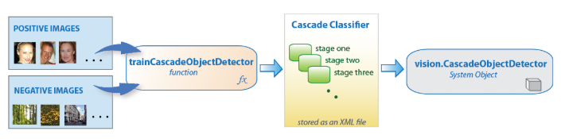
4.Project Details Detection:
Detection is done by the help of OpenCV and Haar cascades.
Face detection using Haar cascades is a machine learning based approach where a cascade function is trained with a set of input data.
OpenCV already contains many pre-trained classifiers for face, eyes, smiles, etc. One such module is Haar Cascades.
Package : OpenCV-python, Numpy
CascadeClassifier:cv2.CascadeClassifier('haarcascade_frontalface_default.xml')

Slide 12
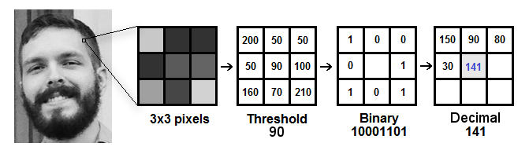
Recognition:
Recognition is done by LBPH recogniser.
Local Binary Pattern (LBP) is a simple yet very efficient texture operator which labels the pixels of an image by thresholding the neighborhood of each pixel and considers the result as a binary number.
It can represent local features in the images. It is possible to get great results (mainly in a controlled environment). It is robust against monotonic gray scale transformations
Recognizer: cv2.face.LBPHFaceRecognizer()

Slide 13
Manage record in Excel files & Statistics by GUI:
Excel file records USN ,Name , date and time of students attending the lecture.
File name is Subject name followed by Date and time of commencement of class.
Saved in .csv format .
Uses Packages : Pandas ,Csv , os and matplotlib.pyplot.

Slide 14
FlowChart
Input: Live video
Detection
yes
Recognition
Matched
Generate Attendance sheet
no
Trained Model(.yml)

Slide 15
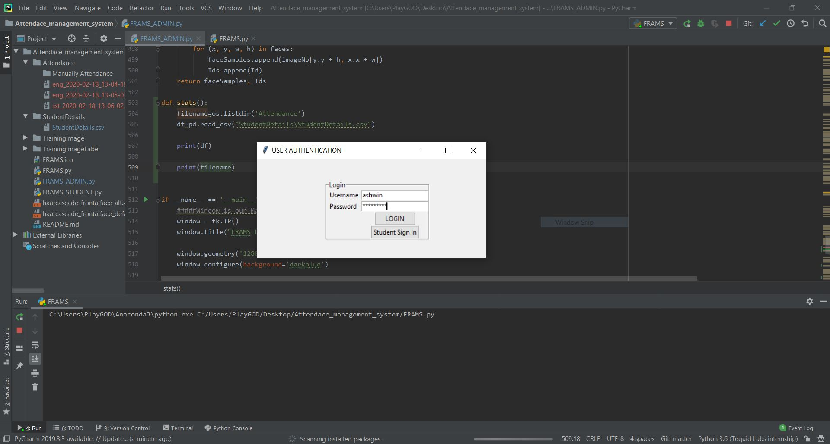
Screenshots

Slide 16
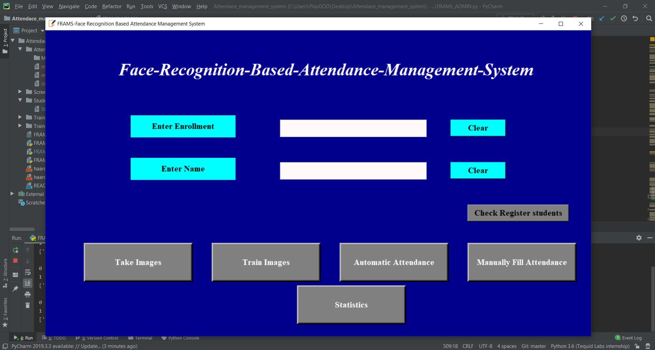

Slide 17
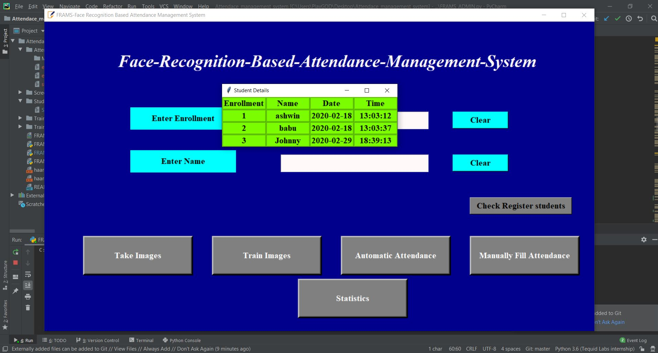

Slide 18
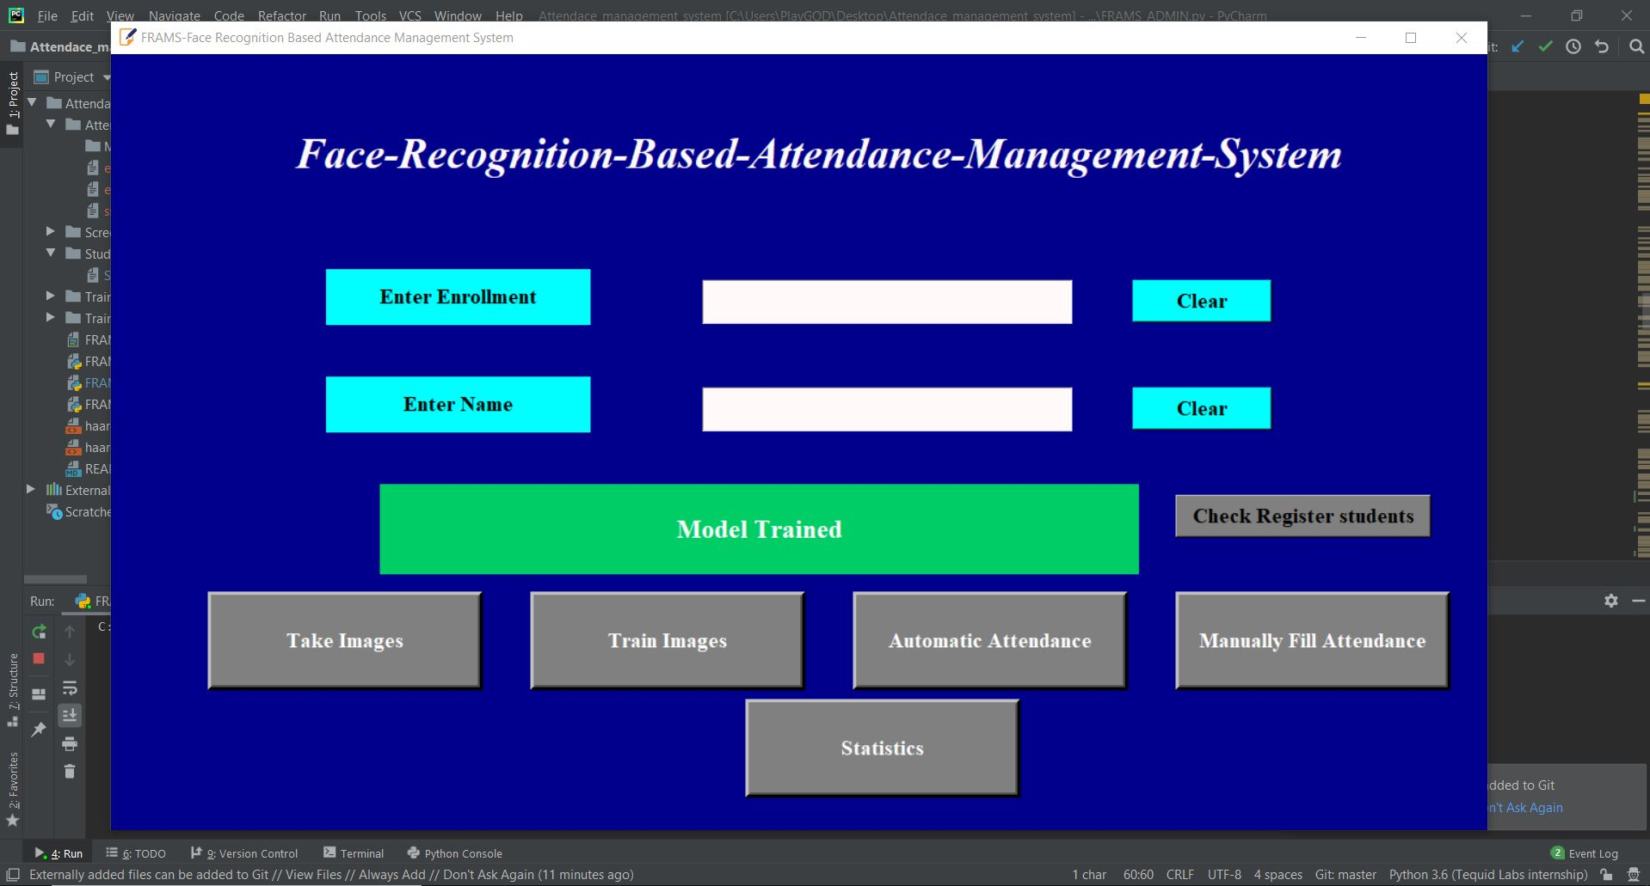

Slide 19
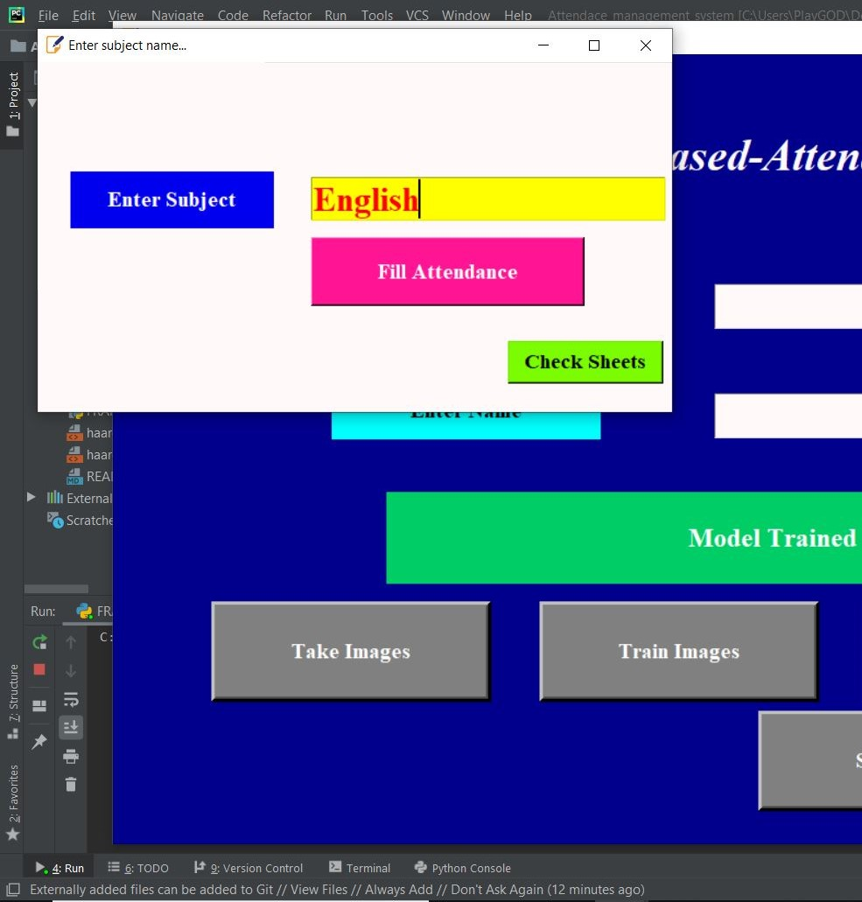
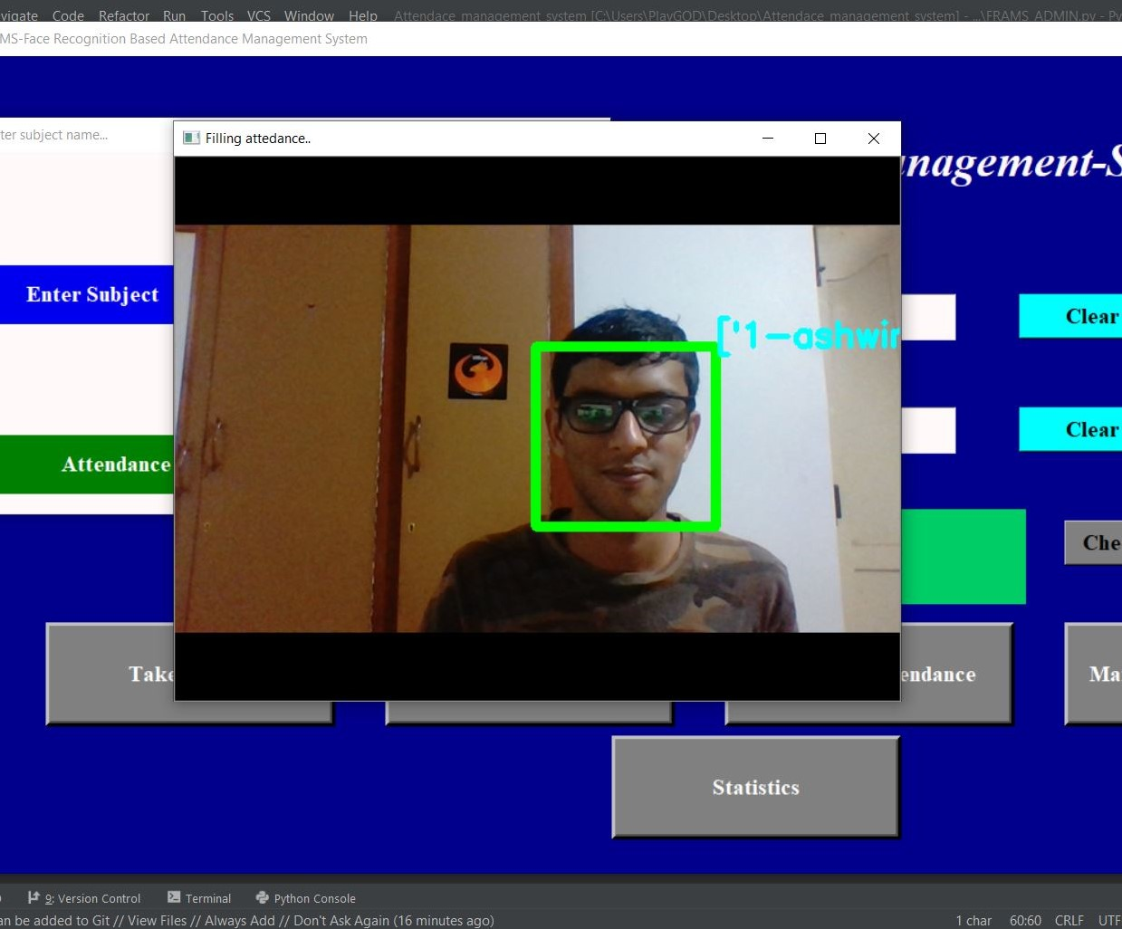

Slide 20
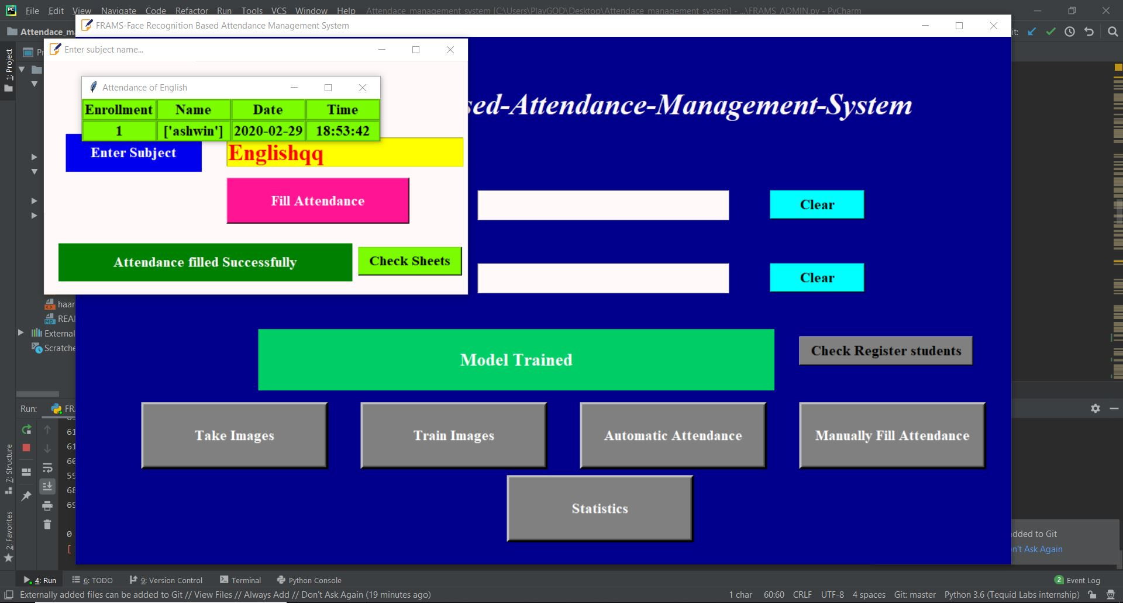

Slide 21
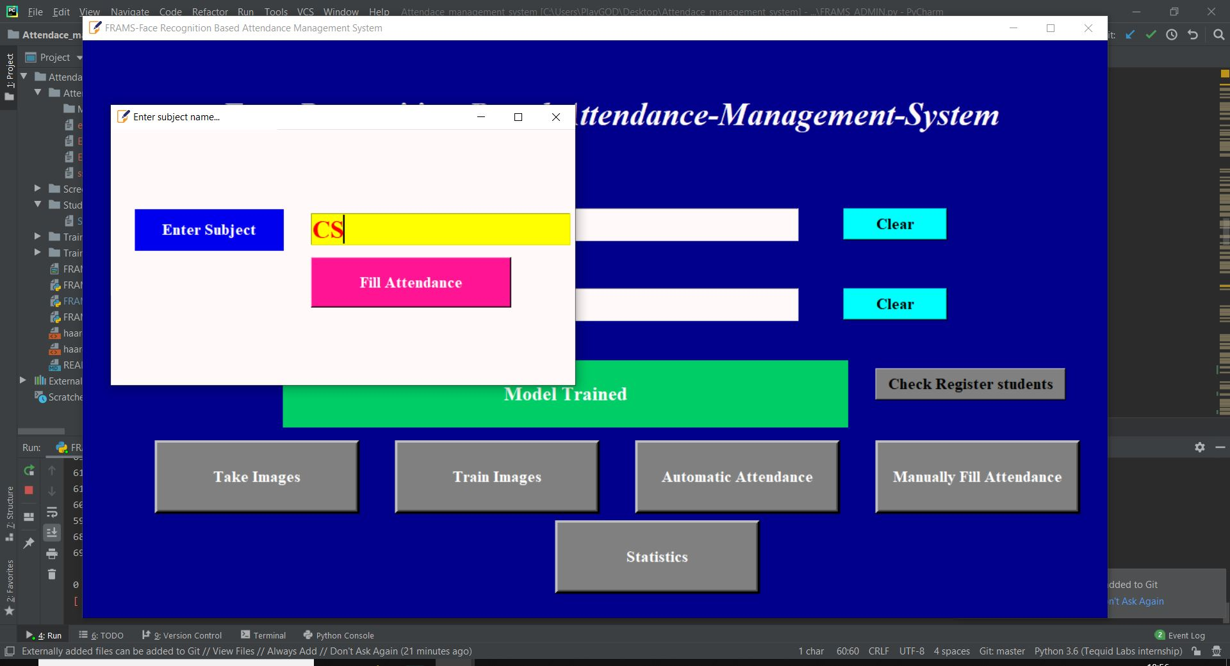
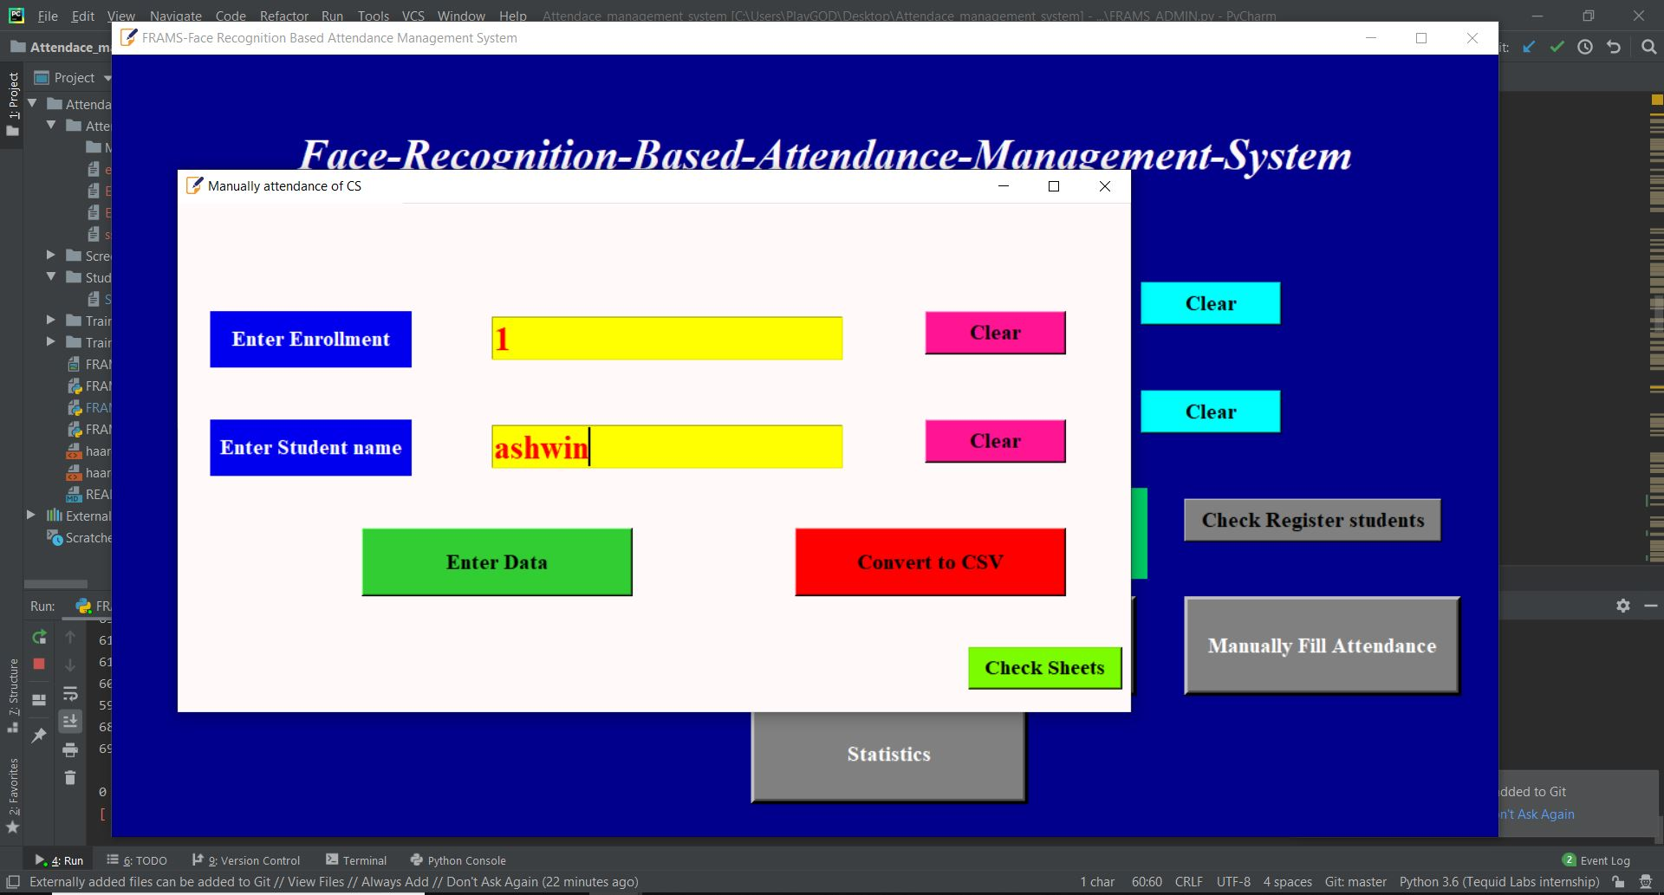
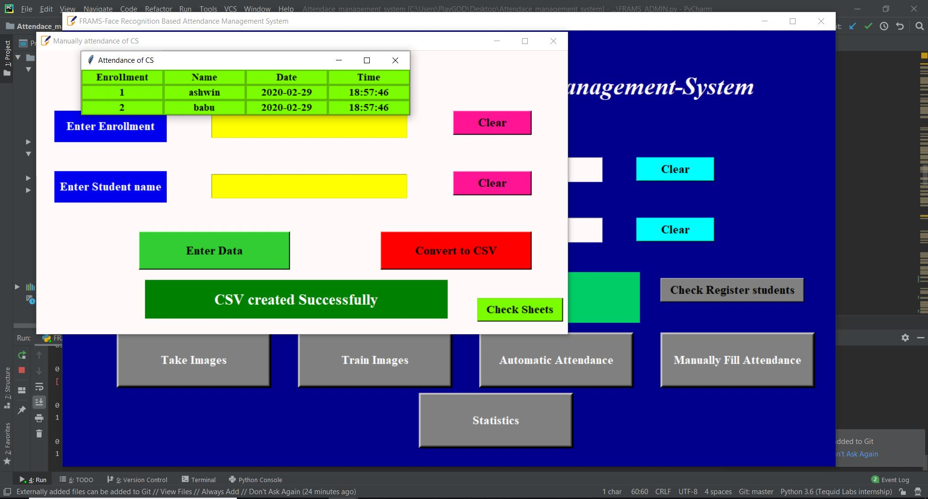

Slide 22
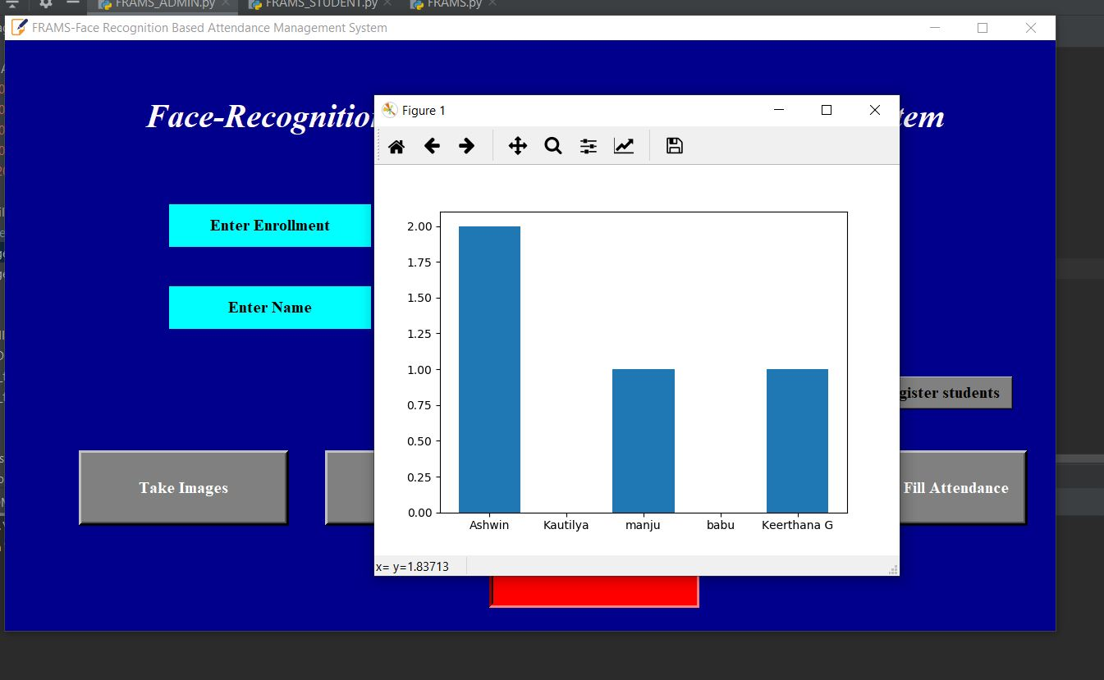

Slide 23
5. Conclusion
Saving time, cost and resource are some of the main benefits we get through automated attendance system. It also reduces human efforts which helps teachers to get more time for teaching.
Authorities can easily generate systematic reports on a weekly or monthly basis and take timely decisions.
Technology updates like Artificial Intelligence and Machine learning is reshaping the world which helps you to have information at your fingertips.

Slide 24
THANK YOU

